Slide 1
Knowledge-aware Coupled Graph Neural Network for Social Recommendation
Chao Huang , Huance Xu , Yong Xu，JD Finance America Corporation，AAAI-2021
KCGN
2021.04.09

Slide 2
Knowledge-aware Coupled Graph Neural Network for Social Recommendation
Motivation
The majority of existing models
  Only consider users’ connections, ignoring knowledge across items;
  Designed for singular type of user-item interactions;
  Less explored dynamic nature of user-item interactions.
KCGN

Slide 3
Knowledge-aware Coupled Graph Neural Network for Social Recommendation
Motivation
The majority of existing models
  Consider users’ connections, ignoring knowledge across items only;
  Designed for singular type of user-item interactions;
  Less explored dynamic nature of user-item interactions.
Knowledge relation
Heterogeneous Graph
Temporal Encoder
KCGN

Slide 4
Knowledge-aware Coupled Graph Neural Network for Social Recommendation
Challenge
  Non-linear aggregation functions can only learn the local proximity
  Handle the dynamic multi-behavior user-item interactions
KCGN

Slide 5
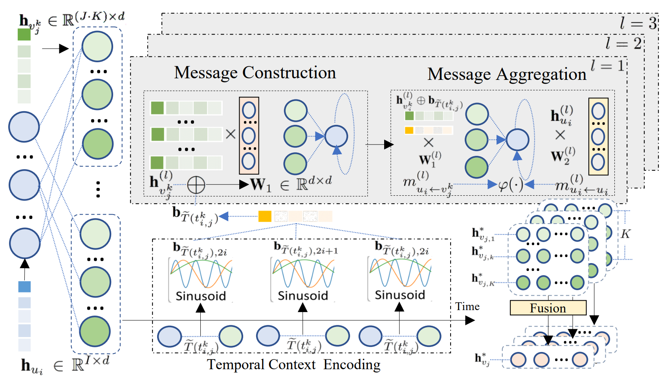
Knowledge-aware Coupled Graph Neural Network for Social Recommendation
Methodology
KCGN

Slide 6
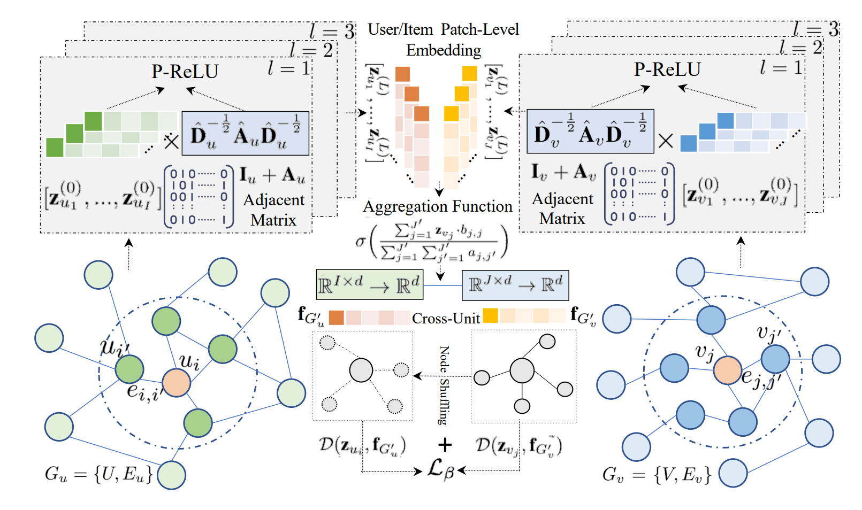
Knowledge-aware Coupled Graph Neural Network for Social Recommendation
Methodology
KCGN

Slide 7


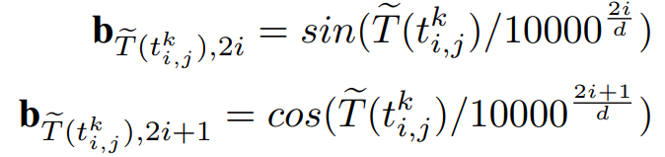
Knowledge-aware Coupled Graph Neural Network for Social Recommendation
Methodology
Multi-Behavior Interactive Pattern
Temporal Context Encoding
KCGN

Slide 8
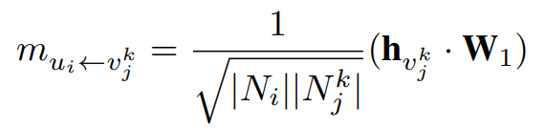
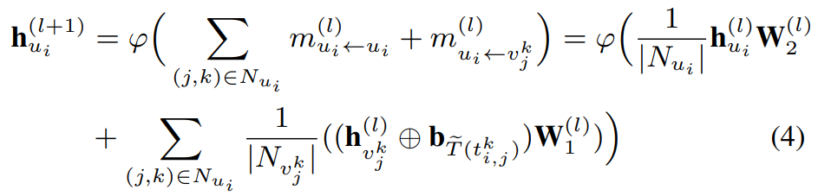
Knowledge-aware Coupled Graph Neural Network for Social Recommendation
Methodology
Message Construction
Message Aggregation
KCGN

Slide 9
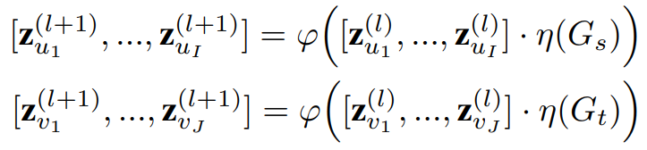
Knowledge-aware Coupled Graph Neural Network for Social Recommendation
Methodology
Local Relational Structure Modeling
KCGN

Slide 10
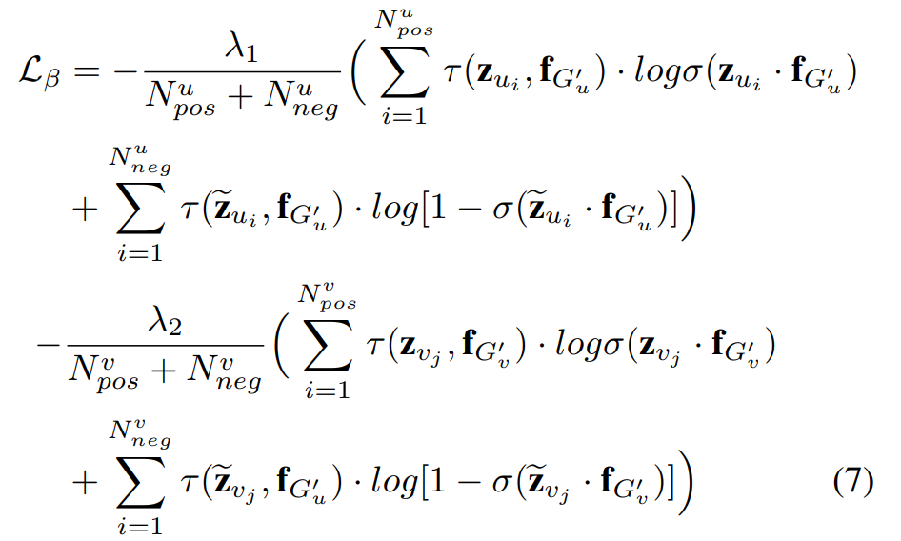
Knowledge-aware Coupled Graph Neural Network for Social Recommendation
Methodology
Encoding of Local and Global
KCGN

Slide 11
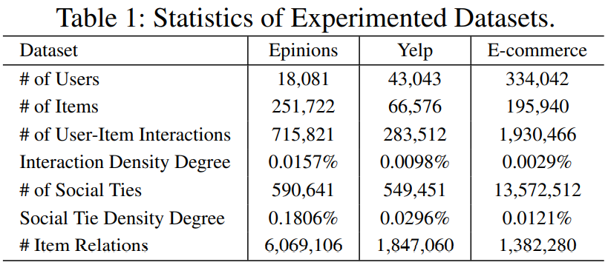
Knowledge-aware Coupled Graph Neural Network for Social Recommendation
Experiment
Dataset
KCGN

Slide 12
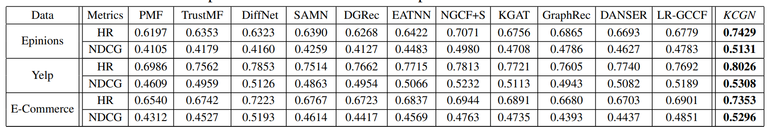
Knowledge-aware Coupled Graph Neural Network for Social Recommendation
Experiment
Effect
KCGN

Slide 13
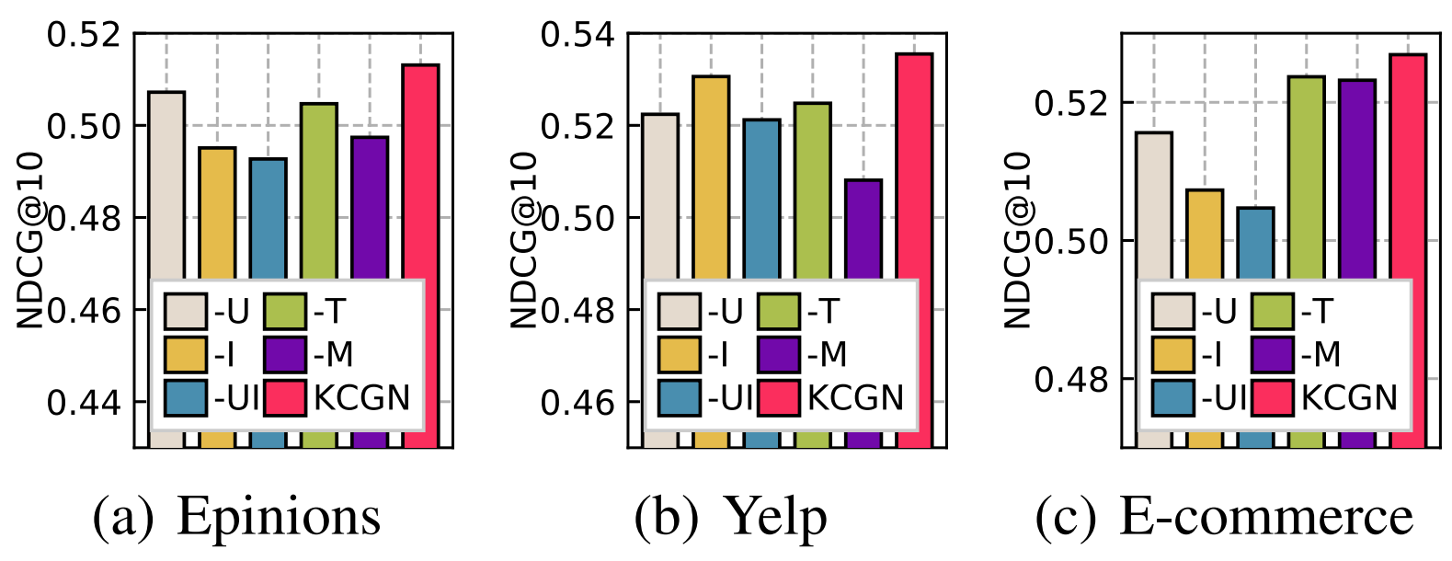
Knowledge-aware Coupled Graph Neural Network for Social Recommendation
Experiment
Ablation
KCGN

Slide 14
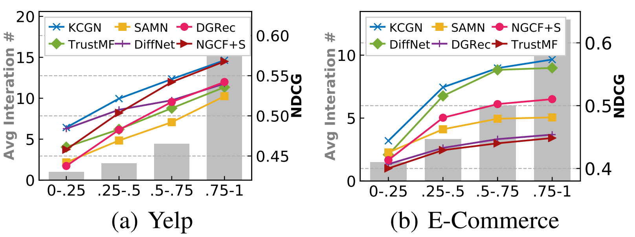
Knowledge-aware Coupled Graph Neural Network for Social Recommendation
Experiment
Performance over sparsity
KCGN

Slide 15
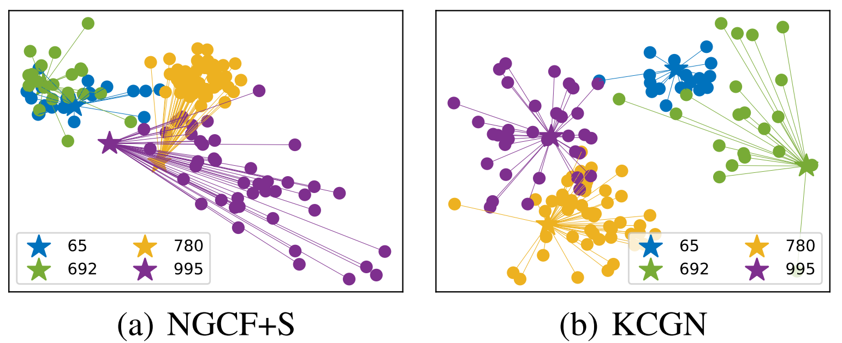
Knowledge-aware Coupled Graph Neural Network for Social Recommendation
Experiment
Qualitative analyses
KCGN

Slide 16
Knowledge-aware Coupled Graph Neural Network for Social Recommendation
Contribution
  Consider knowledge across items
  Consider multiple types of user-item interactions
  Position coding represents temporal information
KCGN

Slide 17
Knowledge-aware Coupled Graph Neural Network for Social Recommendation
Deficiency
  Not consider the effects of different kinds of behaviors.
  The different relationships in the knowledge graph are not fully utilized.
KCGN

Slide 18
Knowledge-aware Coupled Graph Neural Network for Social Recommendation
Chao Huang , Huance Xu , Yong Xu，JD Finance America Corporation，AAAI-2020
>> Thanks
For watching <<
KCGN
2021.04.09

